Slide 1

Revolutionizing Disease Diagnosis with Machine Learning and Symptom Mapping
Abhishek Patil - 002713962
Aparna Chavan - 002799851
harsh shah - 002932124
Ruchi kapAdiwala - 002772936

Slide 2

Content
Problem Statement
Data Source Description
Technical Approach and Algorithms
Implementation Environment
Outcomes
Performance Comparison
Conclusion & Evaluations

Slide 3

Problem Statement
The objective of this project is to create a machine learning model that can correctly forecast diseases from a set of symptoms.
The given dataset has two CSV files: one is to train the model, and the other to test it.
To categorize the diseases based on symptom mapping using five distinct machine learning algorithms
Before using the strategies, the effects of excluding unimportant features should be investigated. Finally, we must compare the effectiveness of each strategy and summarize our results.

Slide 4
Data Source Description
The Disease Prediction Dataset is a collection of data in two CSV files, one for training and the other for testing a machine learning model.
Each file has 133 columns, with 132 columns representing symptoms that a person may experience and the last column representing the prognosis.
The symptoms are mapped to 42 different diseases, and the objective is to classify the set of symptoms to the corresponding disease.
Each column can be interdependent on each other, but some columns are irrelevant to predict the disease.

Slide 5
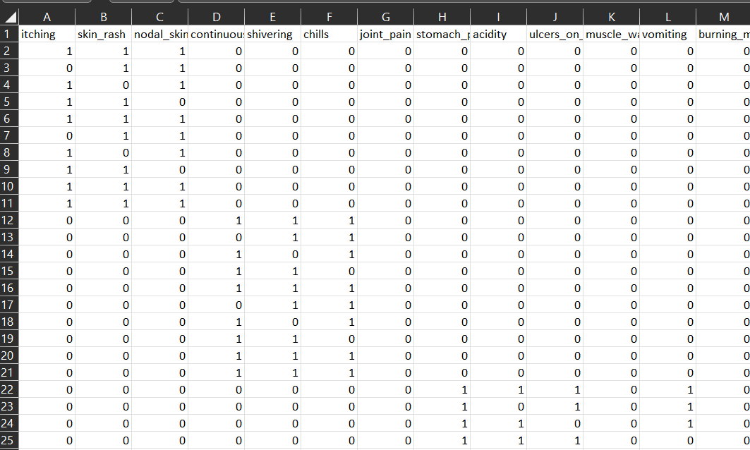
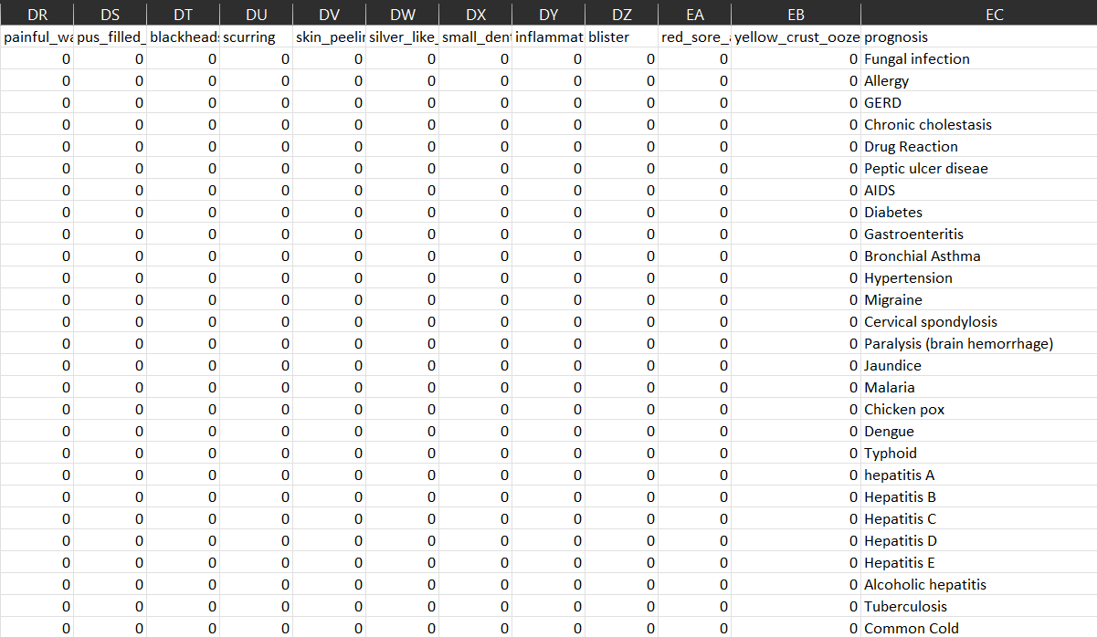
Data Source Description
Training
Testing
In the given dataset, the symptoms columns are one-hot encoded whereas the prognosis column is categorical.

Slide 6
Technical Approach
Data Pre-processing: Loaded training and testing datasets, and then perform data cleaning and transformation to ensure that the data is consistent and accurate. Analyze the data and identify any irrelevant features that can be excluded from the model.
2. Feature Selection: Select the most relevant features that have the greatest impact on the accuracy of the model. We can use feature selection algorithms such as p-value to identify the best subset of features.
3. Model Training: Trained five different machine learning models – Logistic Regression, XGBoost, SVM, Decision tree classifier and Random forest for classification. Use the selected features from the previous step as inputs to these models.
4. Model Evaluation: Evaluate the performance of the trained models using various metrics such as accuracy, precision, recall, and F1-score. Compare the performance of the different models to identify the best-performing model.
5.Model Testing: Use the testing dataset to evaluate the performance of the best-performing model. Generate a confusion matrix to visualize the classification results.

Slide 7
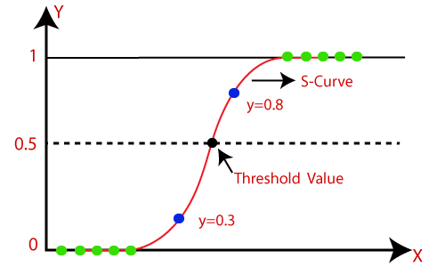
Technical Approach – Logistic Regression
Data Preparation: Clean the data, handling missing values, and converting categorical variables into numerical data.
Splitting the Data: The data is then divided into training and testing sets.
Creating the Model: A logistic regression model is created using the training data. The predicted probabilities of the target class are created by the logistic model by applying a logistic function to a linear combination of the input features.
Training the Model: The logistic regression model is trained using an optimization approach such as gradient descent.
Making Predictions: Once the model is trained, it can be used to make predictions on the testing set. The predicted class labels are obtained by applying a threshold to the predicted probabilities.
Model Evaluation: The performance of the logistic regression model is evaluated using various metrics such as accuracy, precision, recall, F1 score.

Slide 8
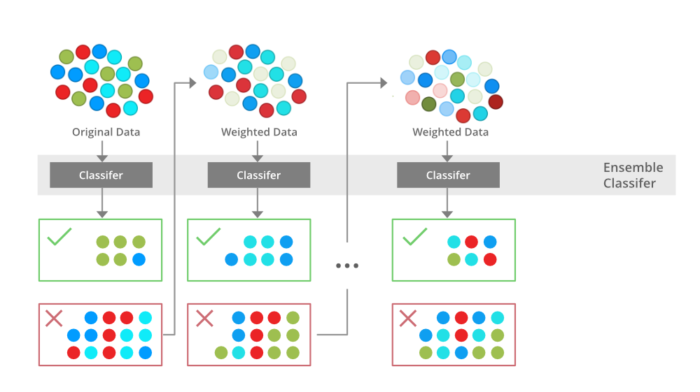
Technical Approach – XGBoost
Load the dataset
Split the dataset: Split the dataset into training and testing sets.
Define the XGBoost model: Create an instance of the XGBoost model and define its hyperparameters. Set the evaluation metric to RMSE using the "eval_metric" parameter.
Train the model: Train the XGBoost model on the training data. The model will learn from the data and try to minimize the loss function to make accurate predictions.
Test the model: Test the XGBoost model on the testing data. The model will make predictions on the testing data and evaluate its performance using RMSE.
Tune the hyperparameters: If the performance of the model is not satisfactory, you can tune the hyperparameters of the XGBoost model.
Make predictions: Once the model is trained and its hyperparameters are optimized, it can be used to make predictions on new data.

Slide 9

Technical Approach – SVM
Load and preprocess the data: Load the dataset you want to use and preprocess it as needed. This may include scaling the features, encoding categorical variables, and splitting the data into training and testing sets.
Choose a kernel: There are several types of kernels you can use with SVM, including linear, polynomial, radial basis function (RBF), and sigmoid. Choose the kernel that is most appropriate for your dataset and problem.
Define the SVM model: Create an instance of the SVM model using the chosen kernel. Set the model parameters, including the regularization parameter C and the kernel parameters (if applicable).
Train the SVM model: Fit the SVM model to the training data. The model will learn the boundary that separates the different classes based on the kernel transformation.
Evaluate the SVM model: Use the trained SVM model to make predictions on the test data. Calculate the accuracy and other performance metrics to evaluate the model's performance.

Slide 10

Technical Approach – Decision Tree
Split the dataset
Train the decision tree model: The DecisionTreeClassifier class from the Scikit-Learn library should be created as an instance, and the model should be trained using the fit() method. The fit method takes the training set as input and learns the decision tree based on the input features and the target variable.
Predict the target variable: Use the predict() method to predict the target variable for the testing set.
Evaluate the performance: Use various performance metrics, such as accuracy, precision, recall, and F1 score, to assess the model's performance. The scikit-learn library provides functions such as classification report() and confusion matrix() to evaluate the performance of the model.
Tune the hyperparameters: Tune the hyperparameters of the decision tree model to improve the performance.
Retrain the model: Retrain the model with the optimal hyperparameters and evaluate its performance.

Slide 11
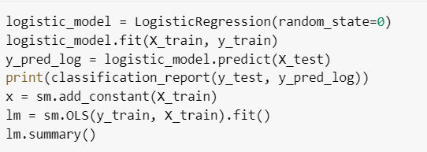
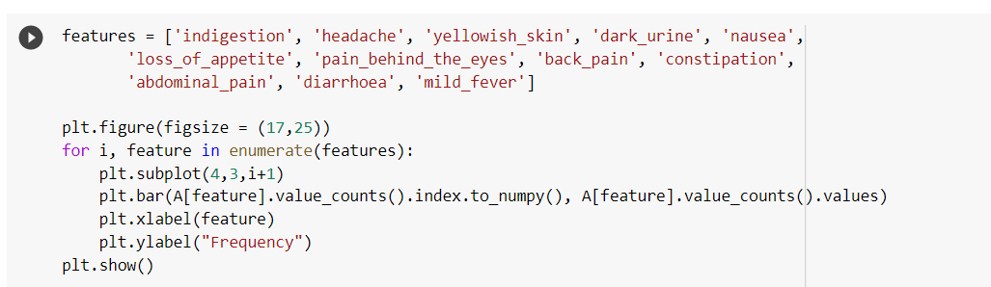
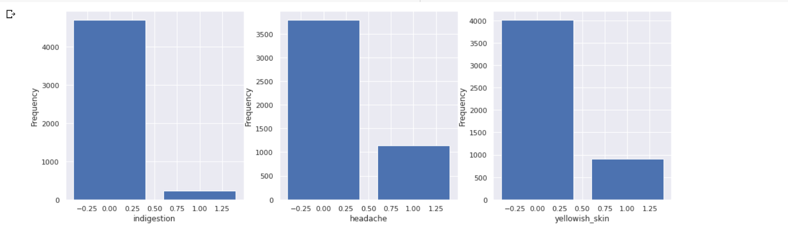
Implementation
We constantly executed logistic regression to remove the unwanted features to predict the disease. This increased the Efficiency and accuracy of the model
We studied the frequency of each symptom and compared the one hot encoded values
A

Slide 12
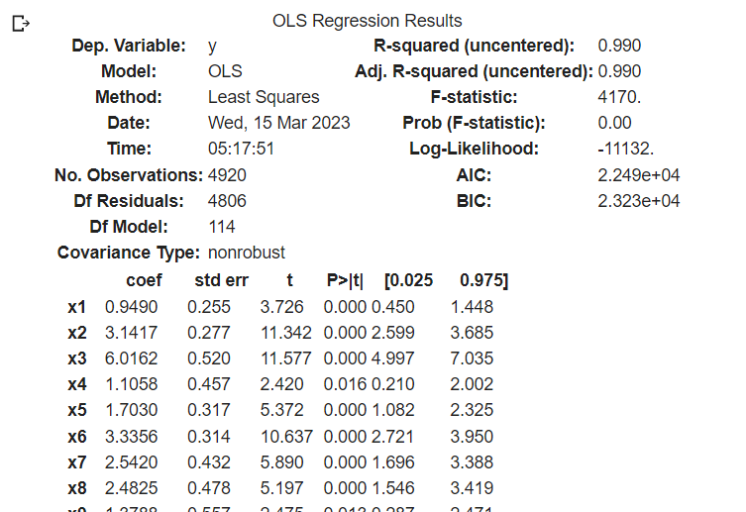
Implementation
Estimated coefficients of linear regression and p-value

Slide 13
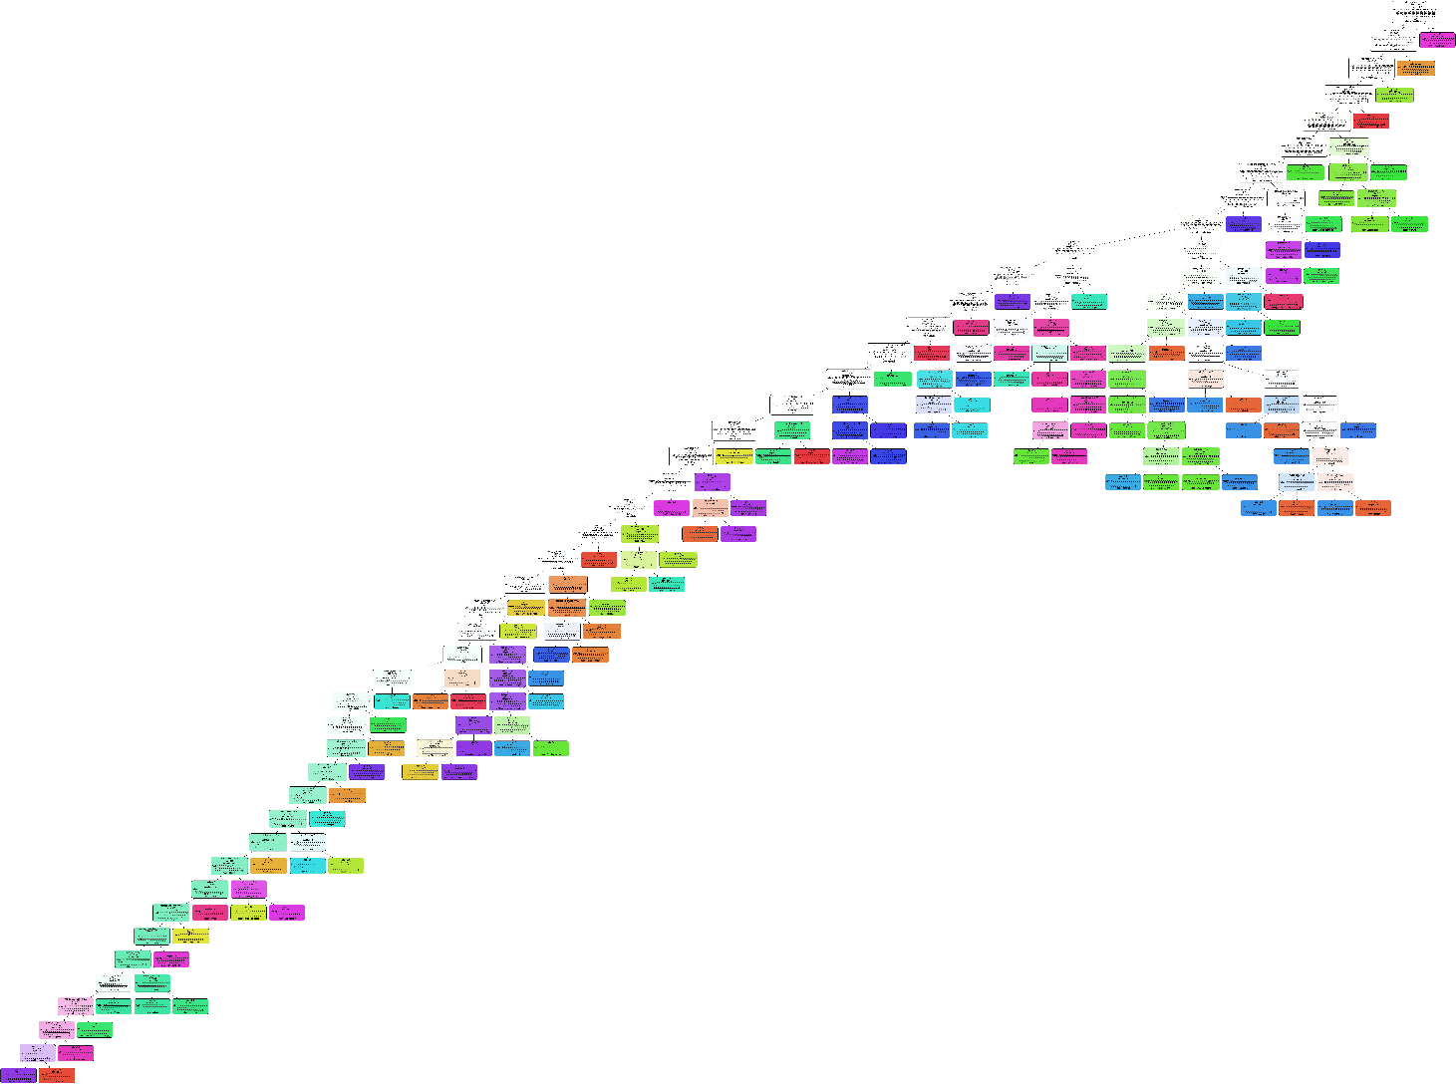
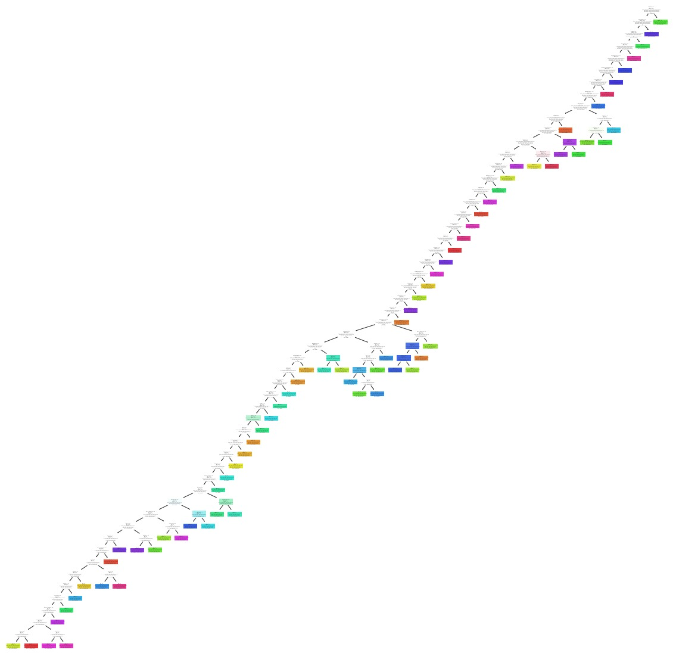
Results
Random Forest
Decision Tree

Slide 14
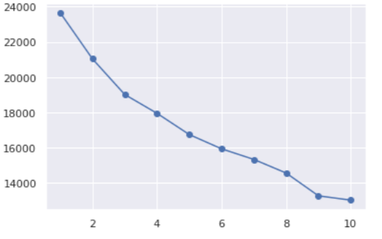
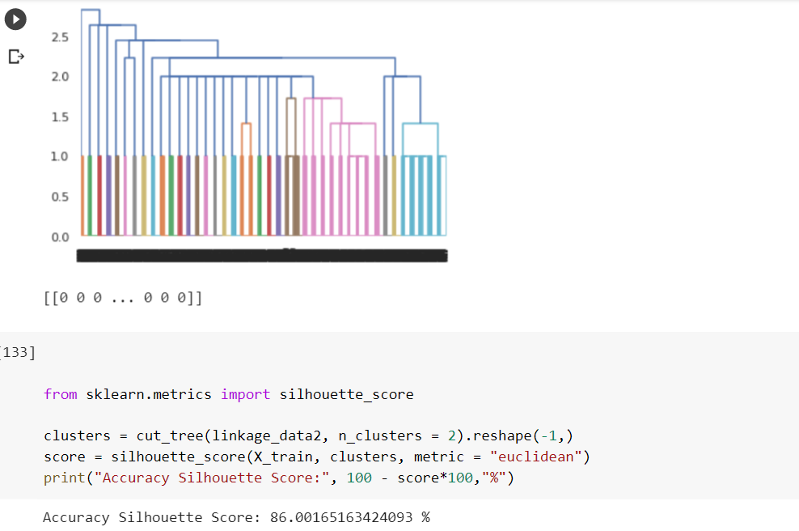
Results
Clustering

Slide 15
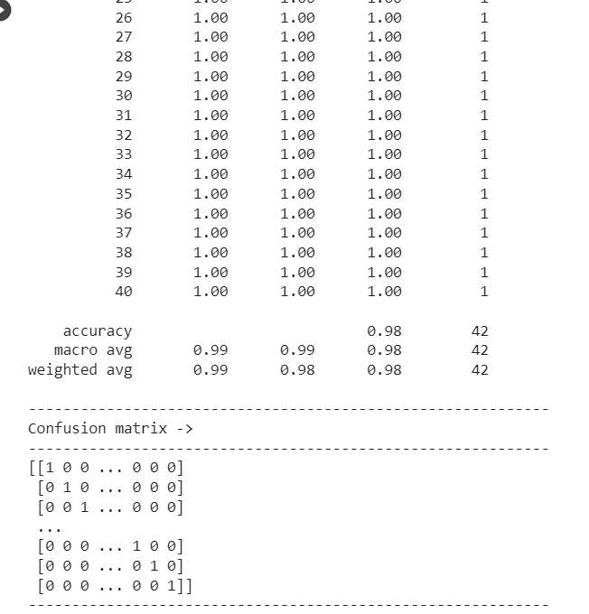
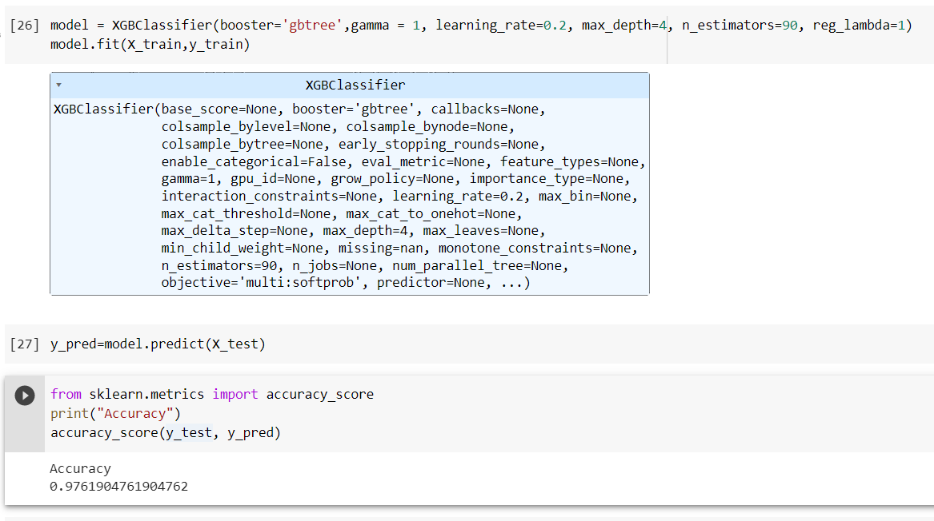
Performance Comparison
XGBoost
SVM

Slide 16
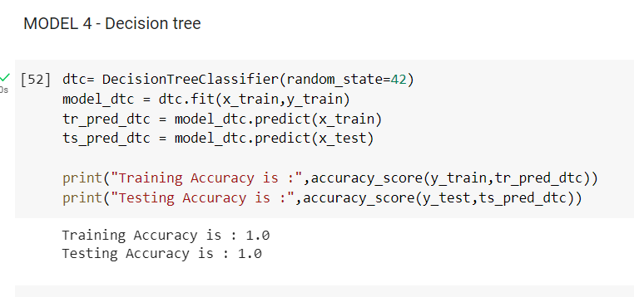
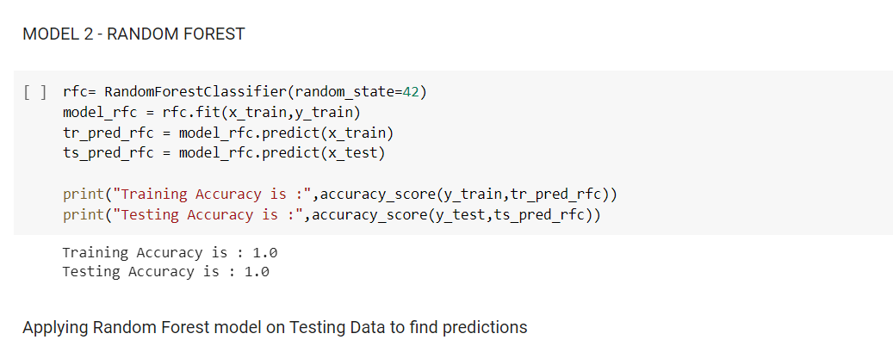
Performance Comparison
Decision Tree
Random Forest

Slide 17
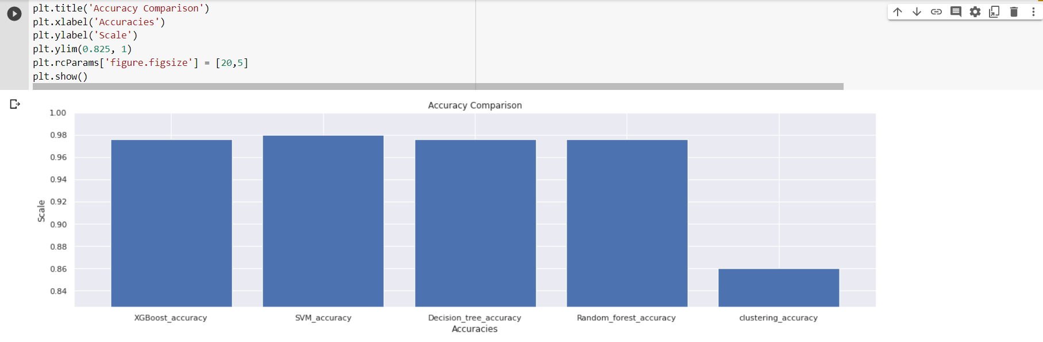
Performance Comparison
Final Accuracy Comparison

Slide 18

Conclusion
After training and testing the models, we compared their performance using evaluation metrics like accuracy, precision, recall, F1-score, and confusion matrix. Based on the evaluation metrics, we found that the SVM model performed the best with an accuracy of 98% and an F1-score of 0.97. The decision tree classifier and the random forest classifier also showed good performance with an accuracy of 97.6% and 97.96% respectively.
In conclusion, based on our analysis, we can say that the SVM model is the best suited for this dataset for classification, followed by decision tree and random forest classifiers.

Slide 19
Contribution
Name | Contribution %
Abhishek Patil | 25%
Aparna Chavan | 25%
Harsh Shah | 25%
Ruchi Kapadiwala | 25%
Total | 100%

